Slide 1
Occupancy Manual
Malia Weinberg Sections

Slide 2
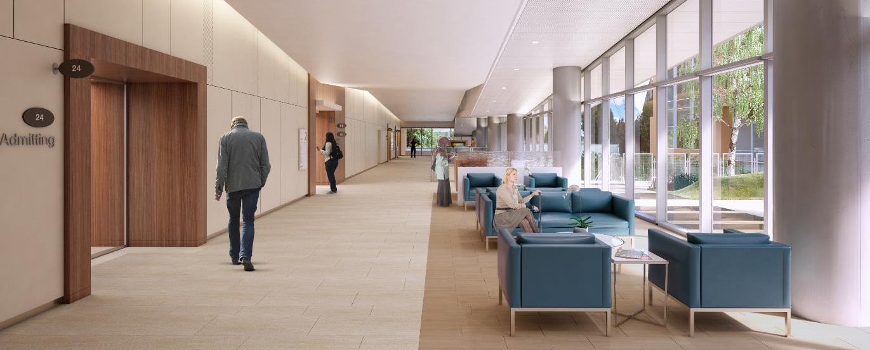
FURNITURE

Slide 3
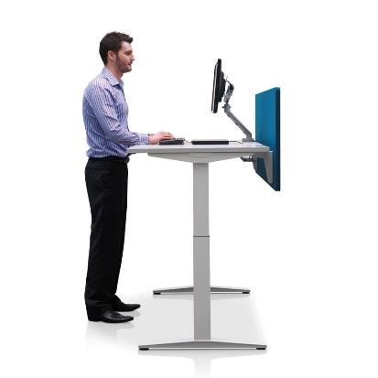
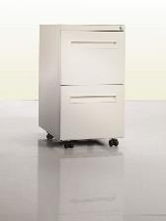
Office spaces
Administrative spaces have
Electric sit/stand desks
Monitor arms
Ergonomic task chairs
Electrical outlets on the desktop for device charging
Mobile personal storage - keys will be provided for assigned locations
Task lighting

Slide 4
Touchdown spaces
Shared among the Mission Bernal Campus floor occupants, including locations such as the interdisciplinary workrooms, nurse stations and MD workrooms
Keyboard trays
Monitors arms
Appropriate lighting
Some storage available - not intended for personal belongings

Slide 5
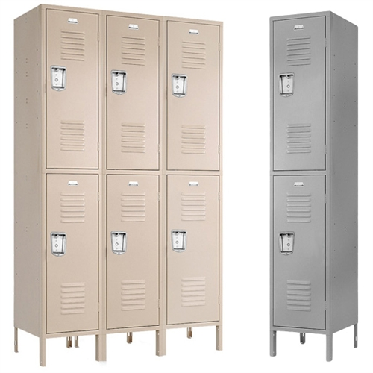
Lockers
The majority of lockers in Mission Bernal will not be assigned to an individual and are planned for day use.
Lockers accept padlocks and are two or three high.

Slide 6
HIPAA - Confidential Document Containers
Confidential document containers are located throughout the hospital. These are emptied every two weeks by the shredding company.
If one needs emptying prior to a regularly scheduled pick up, call the Support Center (x67900) to arrange for EVS to empty it.
Mission Bernal is dedicated to being a green facility, however, so please remember to THINK BEFORE YOU INK.

Slide 7
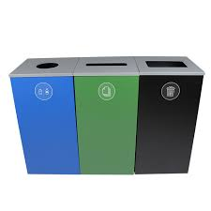
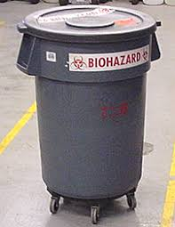
Sustainable Waste Removal
Mission Bernal is designed to be a green hospital. This includes recycling, composting, red-bag (biohazard), pharmaceutical and toxic waste management and medical equipment reuse.
Waste will be separated into streams allowing patients, visitors and staff to contribute to our creating a healthy planet
In office spaces and public areas, receptacles are provided for co-mingled recycling (blue) and regular trash (black).
In the staff lounges and conference rooms there are receptacle for three waste streams co-mingled recycling(blue), regular trash (black), and composting (green).

